Slide 1
Foundations of Artificial Intelligence Fall 2016
Lecture 1: Introduction
Sept 8th 2016
Some images and slides are used from CS188 UC Berkeley, with permission

Slide 2


Instruction Team
Professor:
Dr. Rutu Mulkar-Mehta
me@rutumulkar.com
Office hrs: by appointment
TA:
Luc Gendrot
lgendrot@gmail.com
Office hrs: by appointment

Slide 3
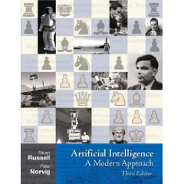
Course Textbook
Artificial Intelligence
A Modern Approach
3rd Edition
Stuart Russell and Peter Norvig

Slide 4
Grading
3 Projects (55% of your grade)
In class problem sets (25% of your grade)
Final exam (15%)
Participation (5%)

Slide 5
Class Participation
Pay attention to the lecture material, and respond to questions in class
Ask insightful questions in class
Ask insightful questions on Piazza
Respond to other students questions on Piazza
Email questions to Professor or TA

Slide 6
In Class Assignments
Every other week we will have an in class assignment for the latter part of the class
In class assignments will last approximately 1 – 1.5 hours.
You can work alone or in pairs
You an leave early if you are done earlier
I’ll drop your lowest problem set grade

Slide 7
Collaboration vs Cheating
You ARE allowed to: talk to other students about concepts in the reading.
You ARE allowed to search the Internet for explanations of concepts covered in the class.
You ARE NOT allowed to: discuss or share the solutions to programming assignments with ANYONE besides me or the TA.
You are NOT allowed to copy partial or complete solutions to programming assignments from the Internet.
If you violate these rules, we will probably find out about it. We will give you a zero for the programming assignment in question.
We will refer your case to the College of Computer Science.

Slide 8
Links
Course Website:
http://rutumulkar.com/cs5100/
Piazza:
https://piazza.com/northeastern/fall2016/cs5100/home
Gradescope
https://gradescope.com/courses/3703

Slide 9
Questions?

Slide 10
Introduction

Slide 11
Why are you in this class?
Groundbreaking progress in the field of AI
We are now seeing things that we saw in movies not too long ago

Slide 12
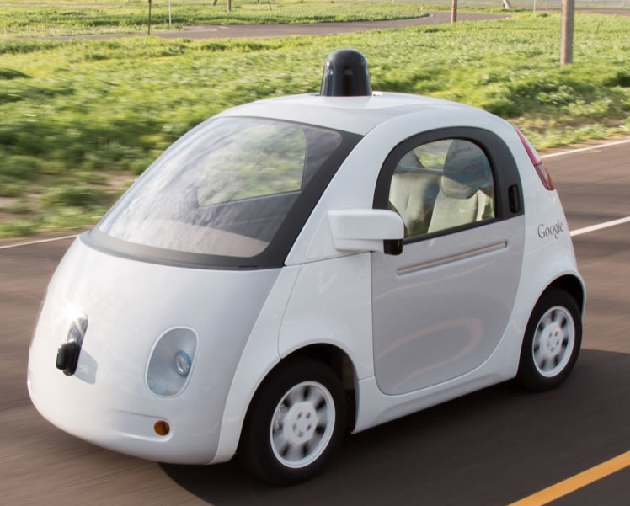
Research Area: Computer Vision
Tesla, Google
Vision
Self Driving Cars
Notes:
We see these cars going about their business close to google plex in the bay area

Slide 13

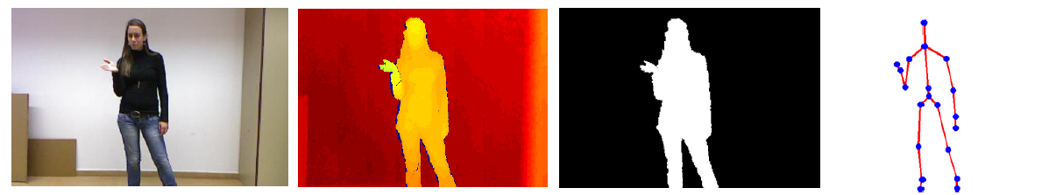
Gesture Recognition
Gesture Recognition
Research Area: Computer Vision
Gaming – Xbox Kinect, Nintendo Wii, Sony Playstation etc.
Notes:
Minority Report

Slide 14

Personalized Advertisement
Research Area: Natural Language Processing, Machine Learning
Movie: Minority Report

Slide 15
Personalized Advertisement
Tom Cruise’s name is “John Anderton” and notice how the vision for personalized advertisement was when the movie was released (2002)
Movie: Minority Report
Research Area: Natural Language Processing, Machine Learning

Slide 16



Machine Translation
Research Area: Natural Language Processing, Machine Learning, Computer Vision

Slide 17
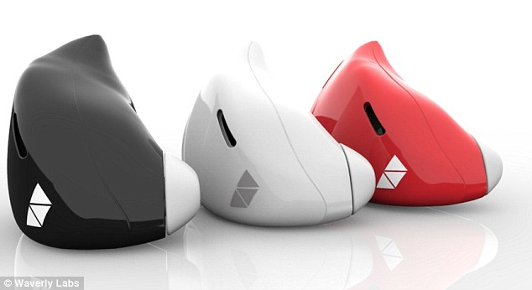
Translation within your Ear

Slide 18
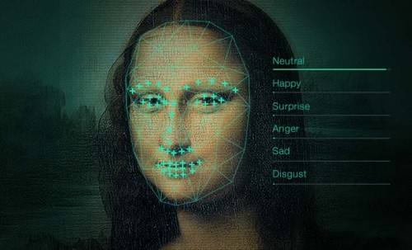
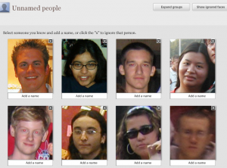
Facial Recognition
Google photos
Research Area: Computer Vision

Slide 19

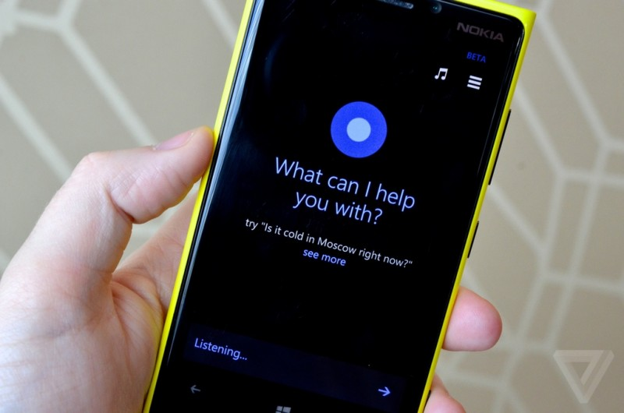

Digital Assistants
Research Area: Natural Language Processing

Slide 20
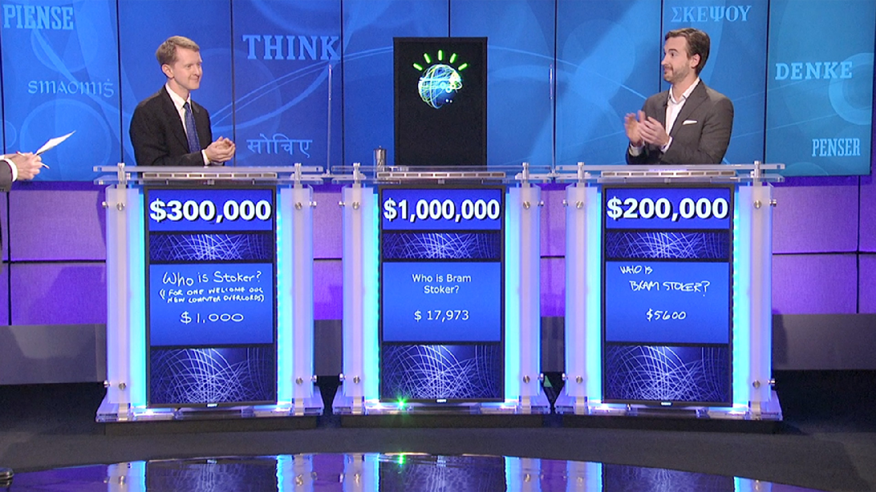
Question Answering
Research Area: Natural Language Processing

Slide 21
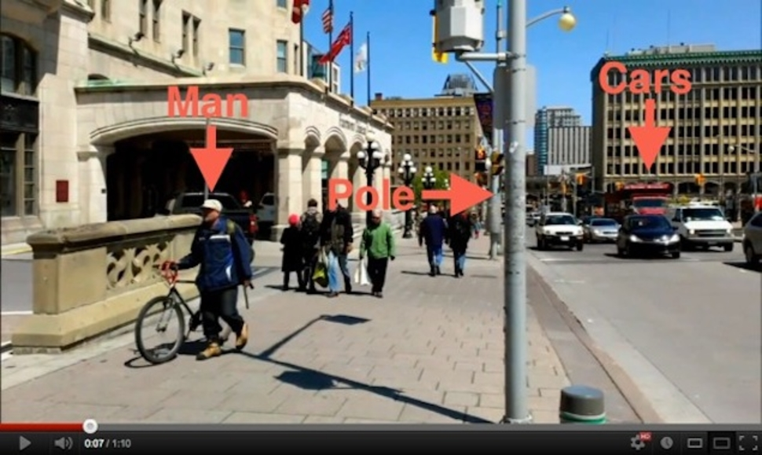
Object Identification
Research Area: Computer Vision

Slide 22
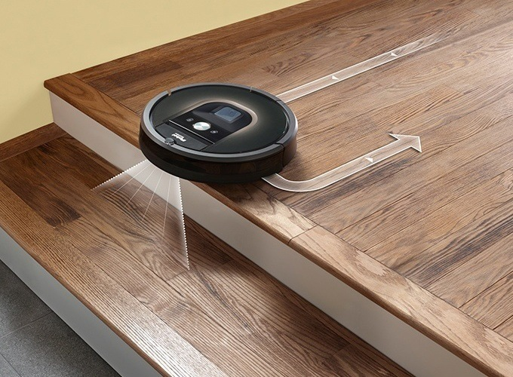
House cleaning (Roomba)
Research Area: Robotics, Computer Vision

Slide 23
Other Areas
Fraud Detection
Email classification (spam, or not spam)
Recommendation Systems
Medical Diagnosis
Airline routing and coordination
Housing Market
ETF management

Slide 24
Subfields of Artificial Intelligence
Natural Language Processing
Computer Vision
Speech Technologies
Robotics
Game Playing

Slide 25
Outline for the Course
Part 1:Search and Plans
Agents
Search
Constraint Satisfaction
Adversarial and Uncertain search
Part 2: Learning
Probabilities
Supervised Machine Learning
Unsupervised Machine Learning
Part 3: Logic and Reasoning
Logic
Knowledge Representation
Reasoning
Notes:
There will be a project and 2 in class assignments for each of these topics

Slide 26
Questions?

Slide 27
Agents

Slide 28
What is an Agent?
An Agent is anything that can be viewed as
perceiving its environment through sensors
acting upon the environment through actuators

Slide 29
Agents
Agent
Environment
Sensors
Percepts
?
Actuators
Actions

Slide 30
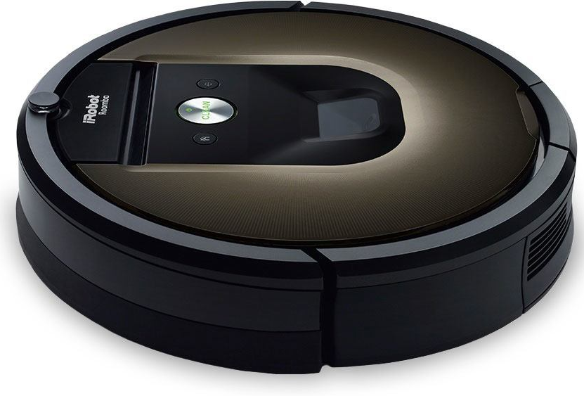

Agent Examples: iRobot Roomba
Agent
Environment
Sensors
Percepts
?
Actuators
Actions

Slide 31

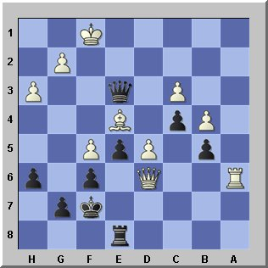
Agent Examples
Agent
Environment
Sensors
Percepts
?
Actuators
Actions

Slide 32
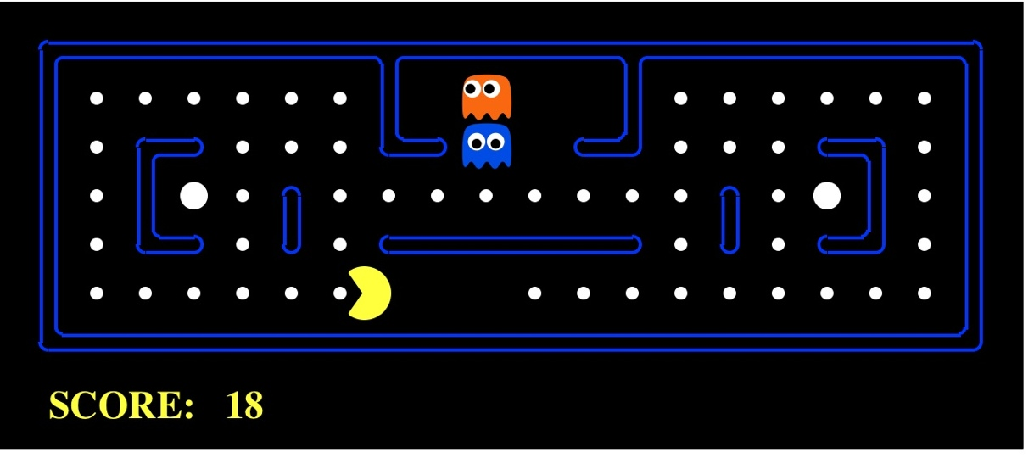
Agent Examples
Agent
Environment
Sensors
Percepts
?
Actuators
Actions
Pac-Man is a registered trademark of Namco-Bandai Games, used here for educational purposes
Notes:
L1D2 =
python demos.py
Select Lecture 1 → select demo 2

Slide 33
Pacman
http://www.playpacmanonline.net/

Slide 34
Rational Agents
A rational agent selects actions that maximize its (expected) utility.

Slide 35
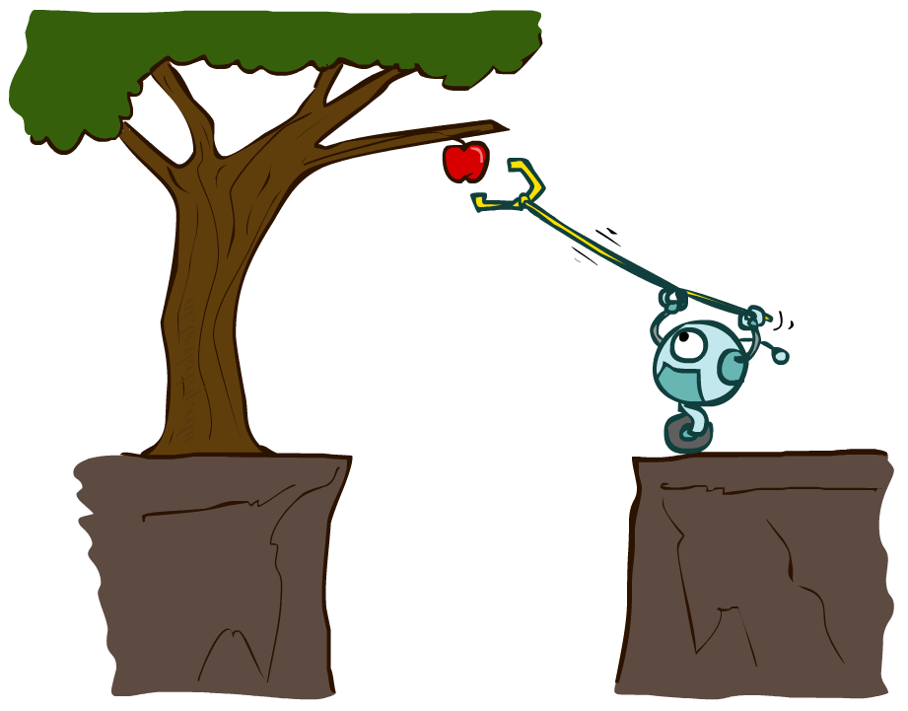
Designing Rational Agents
An agent is an entity that perceives and acts.
A rational agent selects actions that maximize its (expected) utility.
Characteristics of the percepts, environment, and action space dictate techniques for selecting rational actions
This course is about:
General AI techniques for a variety of problem types
Learning to recognize when and how a new problem can be solved with an existing technique
Sensors
Agent
Percepts
Environment
?
Actuators
Actions

Slide 36
Types of Environments
Fully Observable vs Partially Observable
Single Agent vs Multi Agent
Deterministic vs Stochastic
Episodic vs Sequential
Static vs Dynamic
Discrete vs Continuous
Known vs Unknown

Slide 37
Types of Agents
Reflex Agents
Model based reflex agents
Goal Based agents
Utility based agents
Learning Agents

Slide 38
Search
Solving Problems by Searching

Slide 39

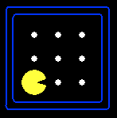





Search Problems
A search problem consists of:
A state space
A successor function
(with actions, costs)
A start state and a goal test
A solution is a sequence of actions (a plan) which transforms the start state to a goal state
“N”, 1.0
“E”, 1.0
Notes:
Often comes back on exams
Goal test – sometimes more than one state that satisfies having achieved the goal, for example, “eat all the dots”
Abstraction

Slide 40

Search Problems Are Models

Slide 41
Example: Traveling in Romania
State space:
Cities
Successor function:
Roads: Go to adjacent city with cost = distance
Start state:
Arad
Goal test:
Is state == Bucharest?
Solution?

Slide 42
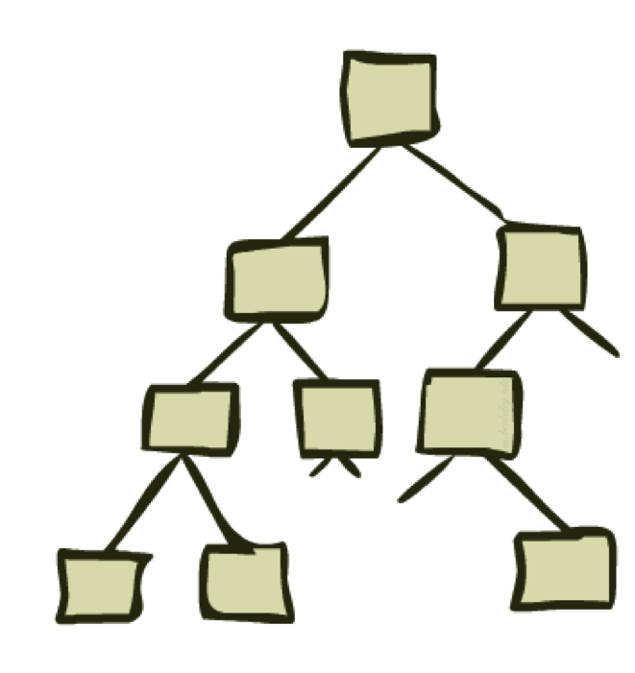
State Space Graphs and Search Trees

Slide 43
State Space Graphs
State space graph: A mathematical representation of a search problem
Nodes are (abstracted) world configurations
Arcs represent successors (action results)
The goal test is a set of goal nodes (maybe only one)
In a state space graph, each state occurs only once!
We can rarely build this full graph in memory (it’s too big), but it’s a useful idea

Slide 44
State Space Graphs
State space graph: A mathematical representation of a search problem
Nodes are (abstracted) world configurations
Arcs represent successors (action results)
The goal test is a set of goal nodes (maybe only one)
In a search graph, each state occurs only once!
We can rarely build this full graph in memory (it’s too big), but it’s a useful idea
a
G
b
c
e
d
f
S
h
p
q
r
Tiny search graph for a tiny search problem

Slide 45
Search Trees
This is now / start
“N”, 1.0
“E”, 1.0
Possible futures
A search tree:
A “what if” tree of plans and their outcomes
The start state is the root node
Children correspond to successors
Nodes show states, but correspond to PLANS that achieve those states
For most problems, we can never actually build the whole tree
Notes:
Different plans that achieve the same state, will be different nodes in the tree.

Slide 46
State Space Graphs vs. Search Trees
State Space Graph
Each NODE in in the search tree is an entire PATH in the state space graph.
Search Tree
S
a
G
d
e
p
b
c
q
b
c
e
h
r
d
e
f
a
a
h
r
p
q
f
S
h
We construct both on demand – and we construct as little as possible.
p
q
f
q
c
G
p
q
r
q
c
G
a
a

Slide 47

Quiz: State Space Graphs vs. Search Trees
Consider this 4-state graph:
How big is its search tree (from S)?
a
S
G
b
Important: Lots of repeated structure in the search tree!

Slide 48
Tree Search

Slide 49
Search Example: Romania

Slide 50
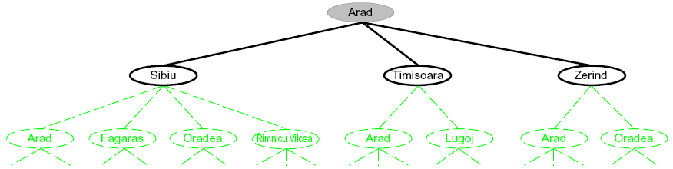
Searching with a Search Tree
Search:
Expand out potential plans (tree nodes)
Maintain a fringe of partial plans under consideration
Try to expand as few tree nodes as possible

Slide 51
General Tree Search
Important ideas:
Fringe
Expansion
Exploration strategy
Main question: which fringe nodes to explore?

Slide 52
Example: Tree Search
a
G
b
c
d
e
f
S
h
p
q
r
Notes:
Left: show tree
Right: fringe

Slide 53

Depth-First Search

Slide 54
Depth-First Search
Strategy: expand a deepest node first
Implementation: Fringe is a LIFO stack
a
G
a
c
b
c
b
e
d
e
d
f
f
S
h
h
p
p
r
q
r
q
S
d
e
p
b
c
e
h
r
q
a
a
h
r
p
q
f
p
q
f
q
c
G
q
c
G
a
a

Slide 55
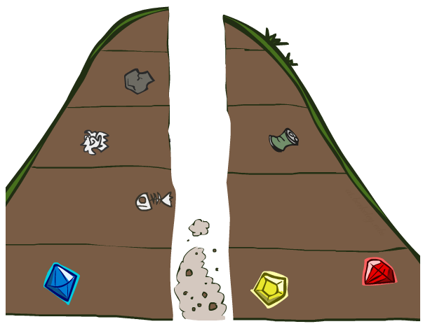
Search Algorithm Properties

Slide 56
Search Algorithm Properties
Complete: Guaranteed to find a solution if one exists?
Optimal: Guaranteed to find the least cost path?
Time complexity?
Space complexity?
Cartoon of search tree:
b is the branching factor
m is the maximum depth
solutions at various depths
Number of nodes in entire tree?
1 + b + b² + …. b^{m} = O(b^{m})
1 node
b
…
b nodes
b² nodes
m tiers
b^{m} nodes

Slide 57
Depth-First Search (DFS) Properties
What nodes DFS expand?
Some left prefix of the tree.
Could process the whole tree!
If m is finite, takes time O(b^{m})
How much space does the fringe take?
Only has siblings on path to root, so O(bm)
Is it complete?
m could be infinite, so only if we prevent cycles (more later)
Is it optimal?
No, it finds the “leftmost” solution, regardless of depth or cost
1 node
b
…
b nodes
b² nodes
m tiers
b^{m} nodes

Slide 58
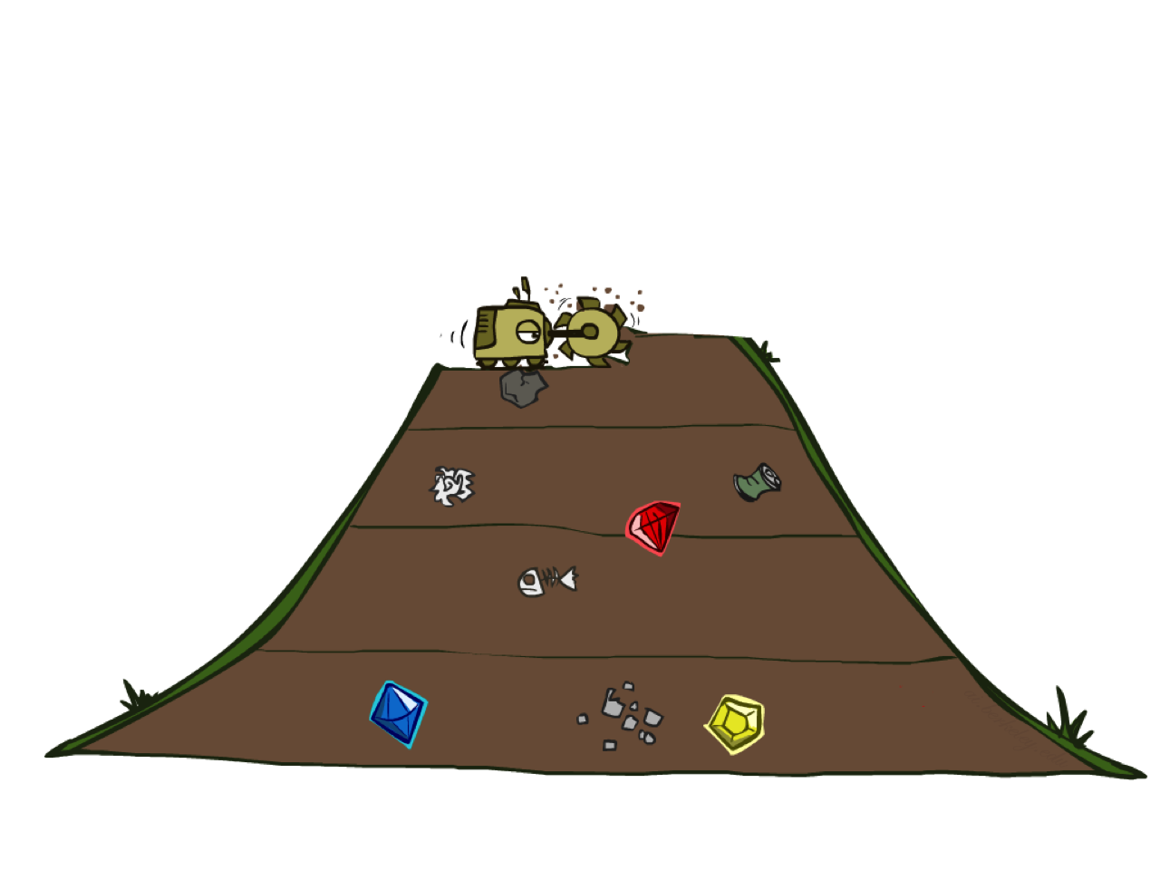
Breadth-First Search

Slide 59
Breadth-First Search
Strategy: expand a shallowest node first
Implementation: Fringe is a FIFO queue
a
G
b
c
d
e
f
S
h
p
q
r
S
d
e
p
Search
Tiers
b
c
e
h
r
q
a
a
h
r
p
q
f
p
q
f
q
c
G
q
c
G
a
a

Slide 60
Breadth-First Search (BFS) Properties
What nodes does BFS expand?
Processes all nodes above shallowest solution
Let depth of shallowest solution be s
Search takes time O(b^{s})
How much space does the fringe take?
Has roughly the last tier, so O(b^{s})
Is it complete?
s must be finite if a solution exists, so yes!
Is it optimal?
Only if costs are all 1 (more on costs later)
1 node
b
…
b nodes
s tiers
b² nodes
b^{s} nodes
b^{m} nodes

Slide 61
Quiz: DFS vs BFS

Slide 62
Quiz: DFS vs BFS
When will BFS outperform DFS?
When will DFS outperform BFS?

Slide 63
Video of Demo Maze Water DFS/BFS (part 1)

Slide 64
Video of Demo Maze Water DFS/BFS (part 2)

Slide 65
Iterative Deepening
Idea: get DFS’s space advantage with BFS’s time / shallow-solution advantages
Run a DFS with depth limit 1. If no solution…
Run a DFS with depth limit 2. If no solution…
Run a DFS with depth limit 3. …..
Isn’t that wastefully redundant?
Generally most work happens in the lowest level searched, so not so bad!
b
…

Slide 66
Quiz
What is the difference between iterative deepening DFS and BFS?

Slide 67
Cost-Sensitive Search
a
GOAL
2
2
b
c
3
2
1
8
2
e
d
f
3
9
8
2
START
h
1
4
2
p
4
r
15
q
BFS finds the shortest path in terms of number of actions.
It does not find the least-cost path. We will now cover
a similar algorithm which does find the least-cost path.

Slide 68

Uniform Cost Search

Slide 69
Uniform Cost Search
2
G
a
Strategy: expand a cheapest node first:
Fringe is a priority queue (priority: cumulative cost)
b
c
1
8
2
2
e
3
d
f
9
8
2
S
h
1
1
p
q
r
15
0
S
d
3
e
9
p
1
b
4
e
5
h
17
r
11
q
16
c
11
Cost contours
a
6
a
h
13
r
7
p
q
f
p
q
f
8
q
c
G
q
c
a
11
G
10
a

Slide 70
Uniform Cost Search (UCS) Properties
What nodes does UCS expand?
Processes all nodes with cost less than cheapest solution!
If that solution costs C* and arcs cost at least ε , then the “effective depth” is roughly C*/ε
Takes time O(b^{C*/ε}) (exponential in effective depth)
How much space does the fringe take?
Has roughly the last tier, so O(b^{C*/ε})
Is it complete?
Assuming best solution has a finite cost and minimum arc cost is positive, yes!
Is it optimal?
Yes! (Proof next lecture via A*)
b
c ≤ 1
…
C*/ε “tiers”
c ≤ 2
c ≤ 3

Slide 71
Uniform Cost Issues
Remember: UCS explores increasing cost contours
The good: UCS is complete and optimal!
The bad:
Explores options in every “direction”
No information about goal location
We’ll fix that soon!
…
c ≤ 1
c ≤ 2
c ≤ 3
Start
Goal
[Demo: empty grid UCS (L2D5)]
[Demo: maze with deep/shallow water DFS/BFS/UCS (L2D7)]

Slide 72
Video of Demo Empty UCS

Slide 73
Video of Demo Maze with Deep/Shallow Water --- DFS, BFS, or UCS? (part 1)
Notes:
Let students guess which one of the three it is. (This is BFS.)

Slide 74
Video of Demo Maze with Deep/Shallow Water --- DFS, BFS, or UCS? (part 2)
Notes:
Let students guess which one of the three it is. (This is UCS.)

Slide 75
Video of Demo Maze with Deep/Shallow Water --- DFS, BFS, or UCS? (part 3)
Notes:
Let students guess which one of the three it is. (This is DFS.)

Slide 76

Fringe Strategies
All these search algorithms are the same except for fringe strategies
Conceptually, all fringes are priority queues (i.e. collections of nodes with attached priorities)
Practically, for DFS and BFS, you can avoid the log(n) overhead from an actual priority queue, by using stacks and queues
Can even code one implementation that takes a variable queuing object

Slide 77
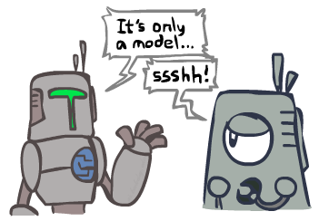
Search and Models
Search operates over models of the world
The agent doesn’t actually try all the plans out in the real world!
Planning is all “in simulation”
Your search is only as good as your models…

Slide 78
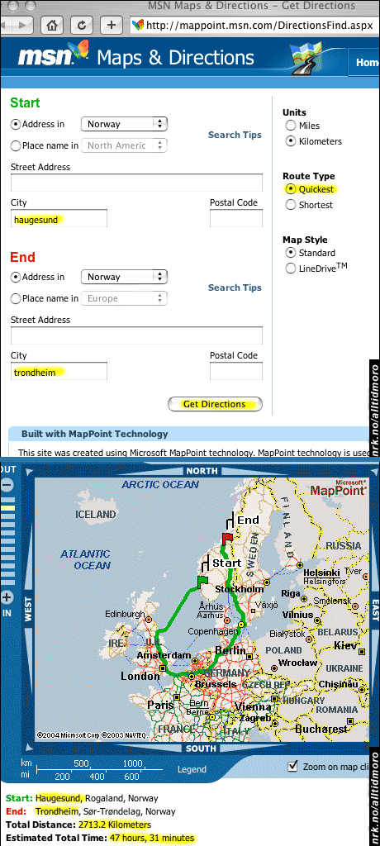
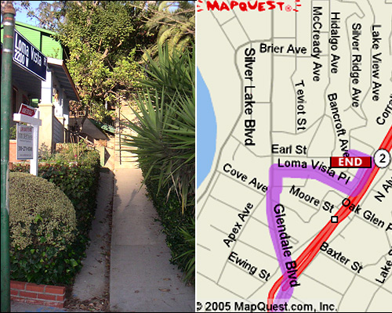

Search Gone Wrong?

Slide 79
Closing Remarks
P0 is out!
Project 1 is out!

